Slide 1


Pharmacy Procedures

Slide 2





A phase III multi-center randomized trial:
VItamin C in Thermal injuRY: The VICToRY Trial
Clinical trials.gov ID #NCT04138394
Sponsor: Dr. Daren Heyland
Principal Investigators:
Dr. Daren Heyland, Critical Care Department, Queen’s University, Kingston, ON, Canada
Dr. Christian Stoppe, Anesthesiology Department, Wurzburg University, Wurzburg, Germany
Dr. Leopoldo Cancio, Director, U.S. Army Burn Center, USAISR, Fort Sam Houston, TX, U.S.A.
Project Leader: Maureen Dansereau, Critical Care Department, Queen’s University, Kingston, ON, Canada

Slide 3
Study Design
High dose IV Vitamin C
x 96 hrs
Placebo
x 96 hrs
Double blind
666 patients
≥18 years of age
Deep 2nd and/or
3rd degree burns
requiring skin
grafting with
TBSA ≥ 20%.
Randomization
Concealed &
Stratified by site
POD+Death

Slide 4
Overall Aim
The overall aim of the VICToRY study is to reduce the burden of illness associated with significant burn injury using a naturally occurring substance, vitamin C!

Slide 5
Hospital Admission
Consent Obtained
Randomization
First Dose of IP
Last Dose of IP
End of Daily Data
3 Month
(Data Censored)
6 Month Survival
Study Overview
Start ASAP (3-6 hrs)!
96 hrs
treatment
3 days additional daily data collection
SF-36 Quality of Life Assessment
Activities of Daily Living
Instrumental Activities of Daily Living
≤24 h (ACU admission to time of consent)

Slide 6

Pharmacy Procedures and
Investigational Product (IP)

Slide 7
Investigational Product (IP)
Active
vitamin C
(ascorbic acid)
Control/Placebo
D5W or
Normal Saline
OR

Slide 8
Investigational Product (IP)
The CERU Project Leader (PL) will work with the pharmacy team at each participating site to set-up procurement of injectable vitamin C and establish payment or reimbursement. This will vary from region to region.
Sites are responsible for maintaining an adequate supply of injectable vitamin C as well as D5W or 0.9% NaCl as diluent and for use as placebo/control (50mL or 100mL IV mini-bags).
You will need an unblinded study team member for IP accountability, preparation and dispensing. If this is not a pharmacy team member, it should be a team member with clinical training, such as a nurse or doctor. Please discuss the use of non-pharmacy team members with the PL.

Slide 9
Storage and Temperature Logs
Different injectable vitamin C products will be used in different regions dependent upon regulatory approvals and availability.
Prior to dilution, products must be stored in accordance with the product monograph.
Once prepared (diluted in D5W or NaCl 0.9%), the vitamin C solution must be stored at 2°- 8°C and protected from light.
The temperature in the IP storage area should be documented everyday. If IP is stored in an area where temperature is monitored, duplicate documentation is not required.

Slide 10
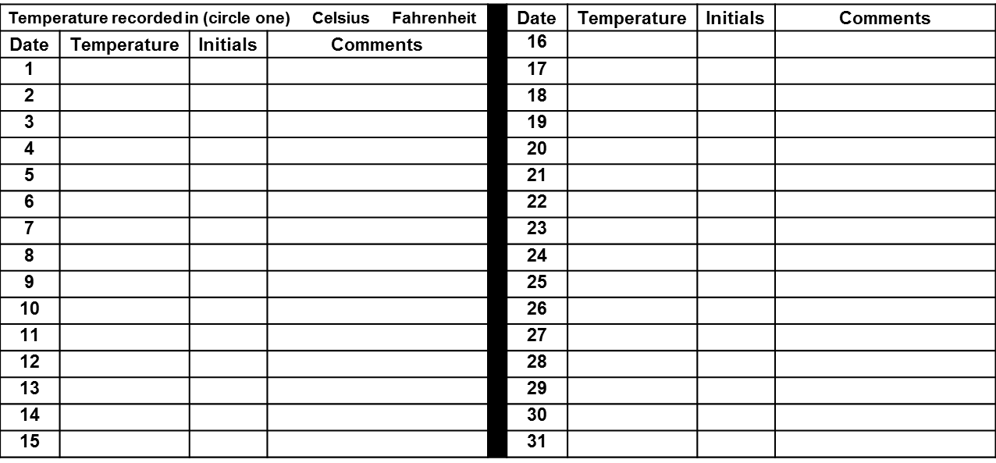
Sample Temperature Log
Site Name ___________________________________________________ Site # _____________
Investigational Product (IP) Name: ________________________ Manufacturer: ___________________________ Required storage conditions: _________________________________ (e.g. 2°- 8° C / 35.6°- 46.4° F protected from light). Record temperature daily. Provide comment for days temperature is not recorded. Keep this log with study IP documents. Provided to Central Pharmacy Manager/Unblinded Monitor upon request.
Month _____________________ Year ______________
Notes:
Example – Ascor / McGuff

Slide 11
Preparation of IP
Use hospital pharmacy supplied D5W/NS as diluent (IV mini-bag).
IP preparation should occur using aseptic technique.
  At some sites this will involve use of a laminar flow hood or isolator.
Once prepared, the solution should be clear & colorless, with no visible precipitates.
Protect the prepared solution from light by placing the IV bag inside a light impermeable container or a light protective bag.
  If using light protective bags, label both IV bag and the light protective bag with the patient label and orders.
Store at 2°- 8°C and keep protected from light until administration.

Slide 12
Preparation of IP
In the event the research pharmacy will not be available:
Vitamin C doses may be prepared in advance and, per stability testing, are stable for 14 days under refrigeration and protected from light.
Weekend and holiday doses may be prepared in advance and stored at 2°-8°C and protected from light in a location that is accessible to the nursing staff who will be administering the IP.
If the weekend or holiday extends 3 or more days, such as Saturday, Sunday, and Monday, sufficient doses to cover the entire treatment period will be prepared on the last day prior to the weekend/holiday. In the example of a long weekend, as noted above, the additional doses will be prepared on Friday.
Notes:
Pre-prepared doses discussed later.

Slide 13
IP Dosing and Administration
IP dose is vitamin C 200mg/kg/day in divided doses, administered q6h, for up to 96 hours (4 days/16 doses) or until hospital discharge.
Patients who weigh more than 150kg will be dosed based on a weight of 150 kg (maximum 30000 mg/day, 7500 mg/dose).
The total daily dose (mg/day) and single dose (mg/dose) will be calculated by the Central Randomization System (CRS). Additional calculations will need to be done by the pharmacy or unblinded delegate preparing the IP solution.
Vitamin C will be diluted in D5W or 0.9% NaCl to a concentration of 36 mg/mL to 92 mg/mL (inclusive).
Infusion rate ≤ 100 mg/min.

Slide 14
IP Dosing and Administration
Preparing doses for patients who weigh <50 kg may require withdrawal and disposal of solution from the mini-bag prior to injecting vitamin C into the bag to ensure a concentration of 36 to 92 mg/mL.
In the example below, we use a product concentration of 500 mg/mL. We do not account for mini-bag overfill in the examples that follow:
Example: 35 kg patient x 200 mg/kg/day = 7000 mg ÷ 4 doses = 1750 mg/dose
  1750 mg/dose ÷ 500 mg/mL = 3.5 mL added to 50 mL mini-bag = 53.5 mL
  1750 mg ÷ 53.5 mL = 32.7 mg/mL (<36 mg/mL = too low)
50 mL mini-bag – 20 mL = 30 mL + 3.5 mL (1750 mg) = 33.5 mL
  1750 mg ÷ 33.5 mL = 52.2 mg/mL (acceptable, 36 to 92 mg/mL).

Slide 15
IP Dosing and Administration
To ensure a final concentration of 36 to 92 mg/mL when preparing doses for patients weighing <50 kg, the following is recommended:
Patient weight is 40 to <50 kg, withdraw and discard 10 mL from a 50 mL mini-bag.
Patient weight is <40 kg, withdraw and discard 20 mL from a 50 mL mini-bag.
Calculations will vary when using different vitamin C concentrations and/or different sized I.V. bags.
Each site is responsible for ensuring a final vitamin C concentration of 36 to 92 mg/mL is attained.
If it is your practice to account for mini-bag overfill, please follow local practice. Ensure your process is clearly documented.

Slide 16
IP Label
Infusion rate must be ≤ 100 mg/min.
The pharmacy/unblinded delegate who has prepared the vitamin C to ensure a concentration of 36 – 92 mg/mL is also responsible for providing the following information on the label for the prepared I.V. solution:
    Final volume (total mL in the bag of prepared solution)
    Minimum infusion time (to ensure a rate ≤ 100 mg/min)
One option for infusion time is to use ranges i.e. for Doses ≤ 6000 mg, infuse IV over 60 mins; For Dose > 6000 mg and up to 7500 mg, infuse IV over 75 mins. (max single dose will not exceed 7500 mg)

Slide 17
IP Label Contents
IP dispensed for administration to study participants should be clearly labeled as in the context of a research study:
Study identification (VICToRY Trial)
Name of Site Investigator
Product Name: Ascorbic Acid OR Placebo (saline 0.9%/D5W)
Participant Name or Initials:
Date IP prepared and expiration date:
Storage conditions: 2°- 8°C and protected from light
Intravenous administration
Total Volume: ________ mL
Minimum Infusion time: _______ min (≤100 mg/min)
For clinical trial use only

Slide 18
Placebo and Maintaining the Blind
To maintain the study blind, placebo/control bags should be prepared so they are indistinguishable from active treatment (vitamin C) bags.
  Placebo bag volume should be similar to what it would be if the patient was randomized to vitamin C, volume could reveal the treatment arm.
  In the example of our 35 kg patient, you would withdraw solution from the placebo bag to a final volume of 33.5 mL
  Placebo bags should be refrigerated if vitamin C is prepared in advance and dispensed after being refrigerated.
  If using Light protective bags for the vitamin C, use Light protective bags for the placebo as well.

Slide 19
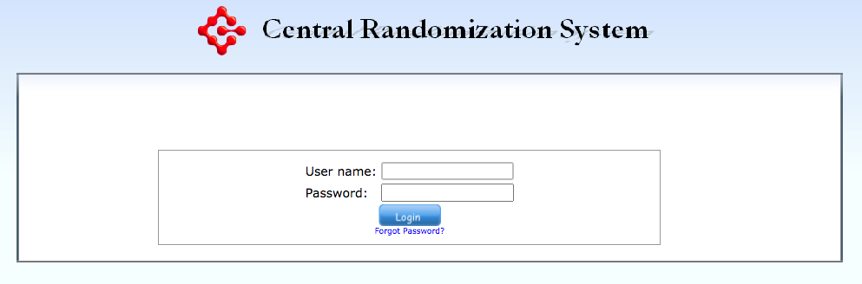
Central Randomization System (CRS)
https://ceru.hpcvl.queensu.ca/EDC2/CRS/

Slide 20
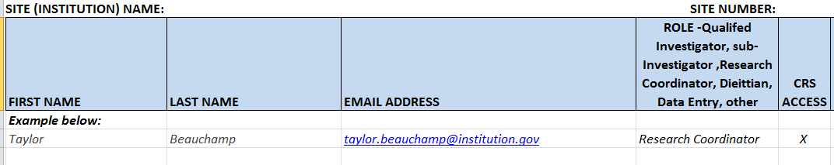
CRS Access
Request access to the CRS by completing the Excel spreadsheet with the name, email address, and study role of each team member who needs CRS access.
Only Pharmacy Team members may choose to have one shared Username and Password, otherwise, each study team member needs their own CRS login and should not share.
Send the Excel sheet to the Project Leader at CERU (via email preferred): Maureen.Dansereau@queensu.ca

Slide 21
CRS Login
If you had access to RE-ENERGIZE, your CRS login for VICToRY will be the same as it was for RE-ENERGIZE.
If you did not have access to RE-ENERGIZE, you will receive an email with your username and temporary password. Change your password the first time you login.
Multi-Factor Authentication (MFA) is required the first time you login and every 30 days thereafter.
Access the CRS (Central Randomization System) at: https://ceru.hpcvl.queensu.ca/EDC2/CRS/

Slide 22
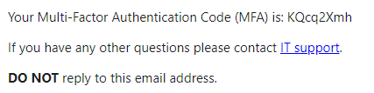
Multi-Factor Authentication (MFA)
A code will be sent to the email you provided when requesting access to the CRS.
For new accounts you will need to create your password and login, you will then be asked for your MFA code. During this process you will receive 2 MFA code emails. Please use the code in the second email.
Email example below:

Slide 23
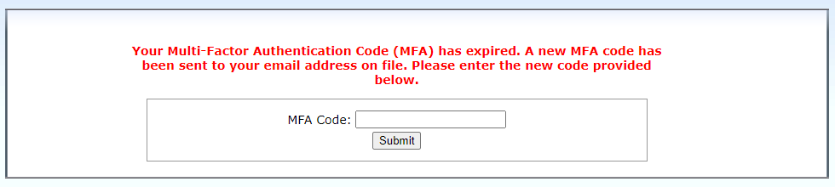
MFA (continued)
Enter the MFA code sent to your email into the CRS where indicated.
The MFA code for the CRS will expire every 30 days.

Slide 24
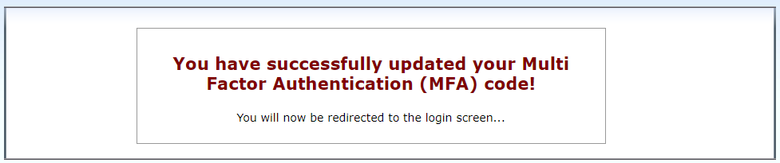
MFA (continued)
Once you have entered your new MFA code you will receive the message above and be redirected to the login screen.

Slide 25
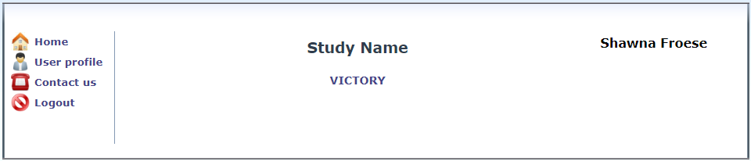
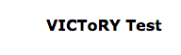
CRS Home Screen
After you Login, you will see a list of studies you are participating in with CERU using the CRS.
Click on VICToRY

Slide 26
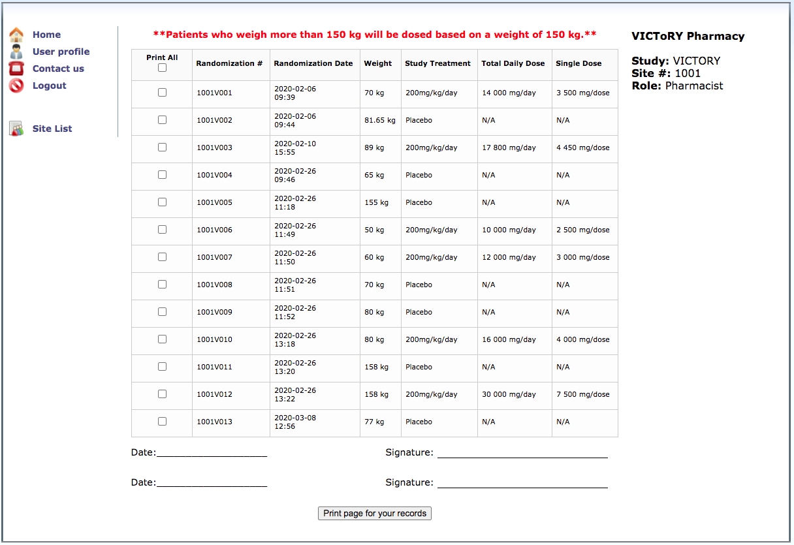
CRS Treatment Assignment
Treatment assignment will be displayed as below:
Notes:
Not adjusting for obesity, dosing all ≥150 kg at 150 kg dose.

Slide 27
CRS Treatment Assignment
Check the Randomization number against the number provider by the Research Coordinator.
Newly randomized patients will appear in the last row on the bottom of the table.

Slide 28
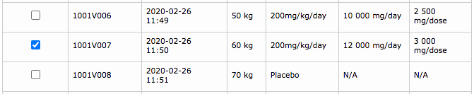
Print and Sign Treatment & Dose
To print a single patient, check the box next to the randomization number of the patient you wish to print.
You may print and sign physically or electronically, but you must maintain documentation that the treatment allocation and dose for each patient was confirmed.

Slide 29
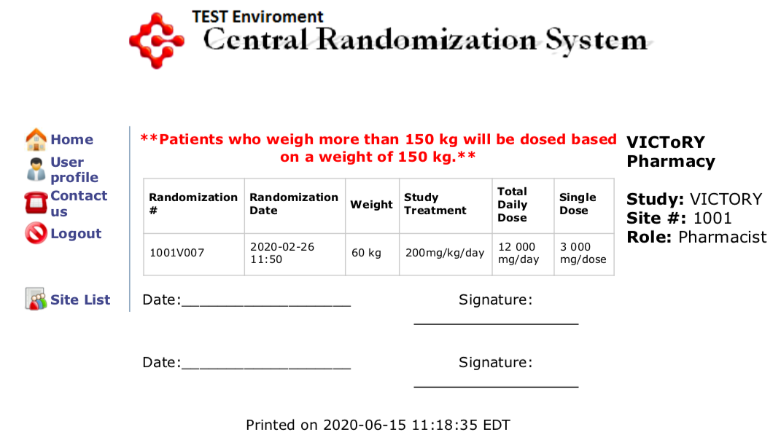
Print and Sign Treatment & Dose
Treatment allocation and dose must be verified and signed by 2 pharmacy/
  delegates.
File with your study documents.

Slide 30
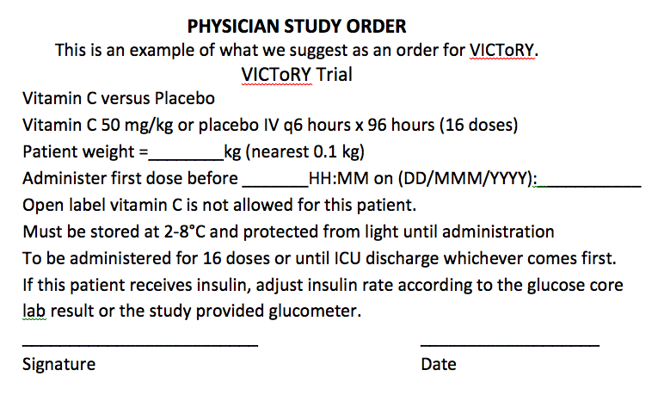
Document Study Orders in the Chart
Ensure the order is signed by the Site Investigator or sub-I.
Open label vitamin C may not exceed 200 mg/day I.V. or 1500 mg/day po
hosp
Notes:
UPDATE: Until HOSPITAL discharge

Slide 31
IP Dispensing and Initiation
The Research Coordinator (RC) will contact the Pharmacy/delegate as soon as the patient is randomized.
RC will provide the patient Randomization number.
Pharmacy/delegate will access the CRS to view treatment allocation and dispense initial dose.
IP is dispensed in mini-bags.
IP is hung and administered bedside by the clinical staff.

Slide 32
Timing of Study Intervention
To ensure the first dose of study intervention is administered in a timely manner, we are requesting vitamin C doses and placebo bags be prepared in advance and stored in a location that is accessible to the research team continuously, 24 hours a day, 7 days per week.
This will prevent delays due to pharmacy/delegate not available to prepare the initial dose or doses at the time of randomization, which may be in the evening/night or on weekends.
Please follow national, regional, and local regulations related to advanced preparation of I.V. vitamins or medications for use in a research study.
If advanced preparation is permitted and approved, please follow the steps on the subsequent slides.

Slide 33
Timing of Study Intervention (continued)
Per stability testing, vitamin C doses may be prepared in advance and are stable for 14 days protected from light and refrigerated at a concentration of 36 to 92 mg/mL.
Advanced doses will be prepared using a patient weight of 110 kg.
  NOTE: Both vitamin C and placebo bags need to be pre-prepared.
Prepared bags must be stored at 2°- 8° C and protected from light.
The bags must be stored in a secure location accessible by the research and IP administration teams.
The prepared product expiration must be clearly displayed on each bag.
Pre-prepared first doses may be used on or off normal business hours.

Slide 34
Timing of Study Intervention (continued)
Vitamin C and placebo bags will be placed in separate containers and labelled with a code that can be clearly communicated to the study team via phone, such as ‘A’ and ‘B’.
Only the unblinded pharmacy team member(s)/delegate(s) will know which product is in each of the two containers.
To ensure continued blinding of the research team, pharmacy/delegate should periodically rotate the study products and allocate new labels. Pharmacy/delegate team must maintain detailed records of what is in each container and the associated labels at all times.
Notes:
Avoid using combinatins easily misunderstood via phone such as ‘B’ and ‘D’, ‘F’ and ‘S’, ‘M’ and ‘N’

Slide 35
Timing of Study Intervention (continued)
After the patient is randomized, the study team member will contact pharmacy and request the pharmacy team member (unblinded delegate) to access the CRS.
The study and pharmacy team members will verify together the following information:
  Randomization number
  Date and Time of randomization
  Patient’s pre-burn dry weight (as entered in the CRS).

Slide 36
Timing of Study Intervention (continued)
Having accessed the CRS, the pharmacy team member (unblinded delegate) will determine the treatment allocation, and then instruct the study team of the following:
  From which container to retrieve a bag for administration to the patient.
  Total volume of the pre-prepared bag to be infused based on the patient’s pre-burn dry weight (per weight entered in the CRS).
  Minimum infusion time or infusion rate to ensure a rate ≤ 100 mg/minute.
Notes:
Avoid using combinatins easily misunderstood via phone such as ‘B’ and ‘D’, ‘F’ and ‘S’, ‘M’ and ‘N’

Slide 37
Timing of Study Intervention (continued)
The research team will verify with the pharmacy/delegate team member:
  The expiration date documented on the bag.
  The container from which the bag was taken
For patients with a pre-burn dry weight of >110 kg, it is not necessary to infuse more than 1 bag as the initial dose.
  Record the initial dose as a one-time order.
  Prepare subsequent doses per the patient’s pre-burn dry weight.
  There is no need to make up for this dose shortage.

Slide 38
Timing of Study Intervention (continued)
The pharmacy team will document the following on the pharmacy randomization confirmation:
  The container from which the team was instructed to take the bag.
  The total volume to be infused that was communicated to the team.
  The minimum infusion time communicated to the research team.
The research team will document the following on the patient randomization confirmation:
  The container from which the bag was taken.
  The total volume to be infused that was communicated to them.
  The minimum infusion time that was communicated to them.

Slide 39
Interrupted or Missed Does of IP
The IP does NOT have to be stopped for procedures or surgery. Whenever possible, the IP should be continued as scheduled.
In the event of an interruption or missed dose, please work to make-up the missed dose(s) as soon as possible after the dose is missed.
Do not administer make-up doses with scheduled doses.
Leave at least one hour between the end of one administration and the start of the next.
Delay the start of the next scheduled dose to accommodate the make-up dose.
It is vital that all doses of IP are administered.

Slide 40
IP Dosing Changes
IP is based on the patient’s pre-burn dry weight.
Patients will remain on the initially calculated dose of IP for the duration of the study.
Since the treatment period is only 96 hours it is unlikely that the patient’s weight will significantly change.
There is no need to adjust the IP dose during the study treatment period.

Slide 41
IP Dispensing Log
Record the IP Dispensed on the IP Dose Dispensing Log

Slide 42
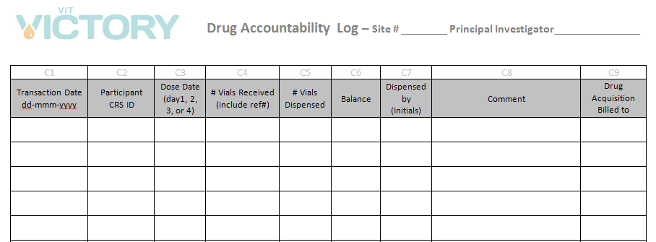
IP Accountability Logs
Maintain IP Accountability Logs for all study products.
Please follow local procedures for disposing of both unused IP and empty bags after the IP has been administered.

Slide 43
Questions
?

